Slide 1
ADA Compliant Sidewalks
Anthony Norman PE KYTC
Jeff Jasper PE KTC
Joe Tucker PE KYTC

Slide 2
Americans With Disabilities Act of 1990
Signed into Law by President George H. W. Bush on 26 July 1990
Amended and signed in 2008 by George W. Bush

Slide 3
Americans with Disabilities Act
Five Titles
  Title I: Employment
  Title II: Public Entities
  Title III: Public Accommodations
  Title IV: Telecommunications
  Title V: Miscellaneous Provisions
Notes:
ADA affects many, many areas of public life. Many are familiar with the fact that ADA affects employment and hiring practices. The list of ADA affects goes on. As for how highways are concerned, you have to go to Title 2.

Slide 4
Title II: Public Entities
Public Entity:
  State or local government and department, agency, special purpose district, or other instrumentality of a state or local government
Notes:
Public Entity:
State or local government and department, agency, special purpose district, or other instrumentality of a state or local government
National Railroad Passenger Corporation or an commuter authority

Slide 5
Title II: Public Entities
Qualified Individual with Disability:
  An individual with a disability who, with or without reasonable accommodations to rules, policies, or practices, the removal of architectural, communication, or transportation barriers, or the provision of auxiliary aids and services, meets the essential eligibility requirements for the receipt of services or the participation in programs provided by a public entity.
Notes:
Qualified Individual with Disability:
An individual with a disability who, with or without reasonable accommodations to rules, policies, or practices, the removal of architectural, communication, or transportation barriers, or the provision of auxiliary aids and services, meets the essential eligibility requirements for the receipt of services or the participation in programs or activities provided by a public entity.

Slide 6
Title II: Public Entities
Discrimination:
  Excluded from participation in or be denied the benefits of the services, programs, or activities of a public entity (i.e. sidewalks), or be subjected to discrimination by any such entity.

Slide 7
KYTC Mission Statement
"To provide a safe, efficient, environmentally sound and fiscally responsible transportation system that delivers economic opportunity and enhances the quality of life in Kentucky."

Slide 8
United States Access Board
Created in 1973 to ensure access to Federally funded facilities, now is the leading source on accessible design information.
Board develops and maintains accessibility design guidance
For sidewalks in public right-of-way: PROWAG.

Slide 9
PROWAG
Public Right of Way Accessibility Guidelines
Access Board`s guidance on Public Right of Way accessibility
In 2011: Updated the PROWAG
  Still needs to be approved, yet is “best practice” for many state agencies.
In 2013: Supplemental information for Shared Use Paths

Slide 10
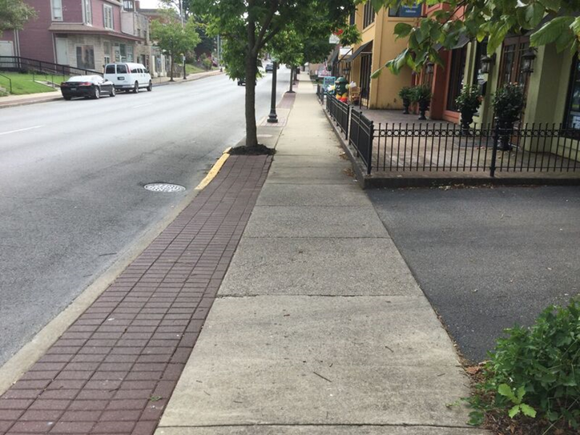
Sidewalk Zones
There are four zones:
  Curb Zone
  Planter/Furniture zone
  Frontage Zone
  Pedestrian/Throughway Zone
    Pedestrian Access Route
Notes:
There are four zones
Curb Zone
Planter/Furniture zone
Space for signs, benches, trees, poles and fire hydrants
Frontage Zone
Displays, Café Seating, Store Fronts, Planters, Overhanging elements
Pedestrian/Throughway Zone
Pedestrian Access Route

Slide 11
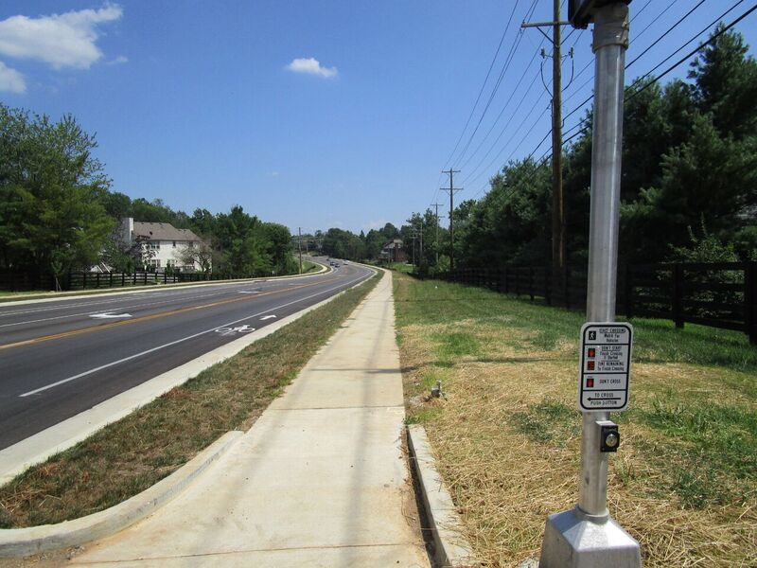
Sidewalk
Minimum width:
  PROWAG: 4 feet (R302.3 & HD Exhibit 700-04)
  KYTC common practice: 5 feet (HD-1501.4)
Surface of pedestrian zone needs to be firm, stable, and slip resistant (R302.7)

Slide 12
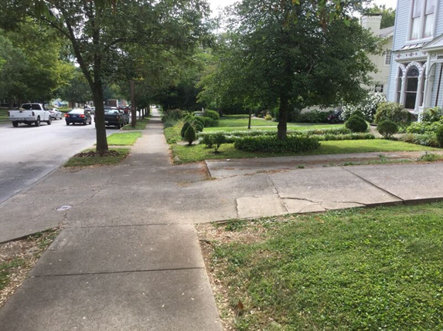
Sidewalk
Protruding Objects:
  Lower then 6.67 feet can only extrude four inches in the pedestrian zone. (R402)
  Signs installed 7 feet above sidewalk. (MUTCD Section 2A.18)

Slide 13
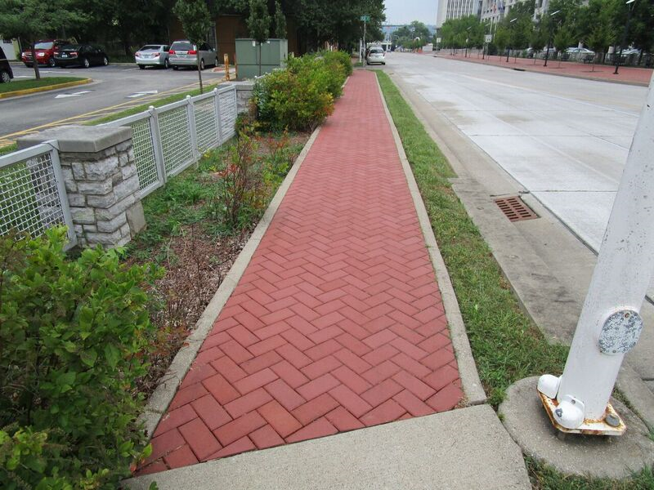
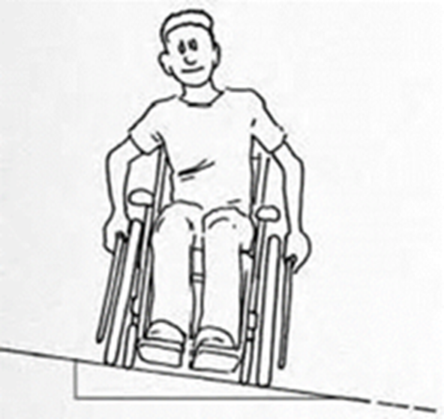
Cross Slope
Slope perpendicular to direction of travel
Slope: not greater than 2% (R302.6)

Slide 14
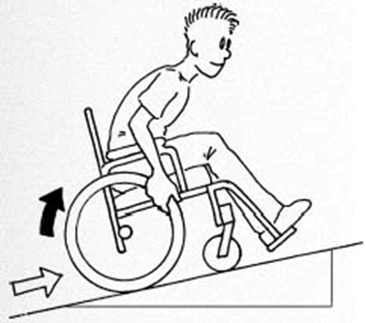
Running Slope
Desirable less than or equal to 5%
In street or highway right of way do not exceed street grade (R302.3.2)

Slide 15
Running Slope
If not in the street or highway right of way, then shall not exceed 5% (R302.3.2)
If compliance is not practicable due to existing terrain, infrastructure, right of way availability, natural feature, similar existing physical constraints, compliance is required to the extent practicable. (R302.5.4)
Notes:
On the last bullet here, say something like “Jeff’s part

Slide 16
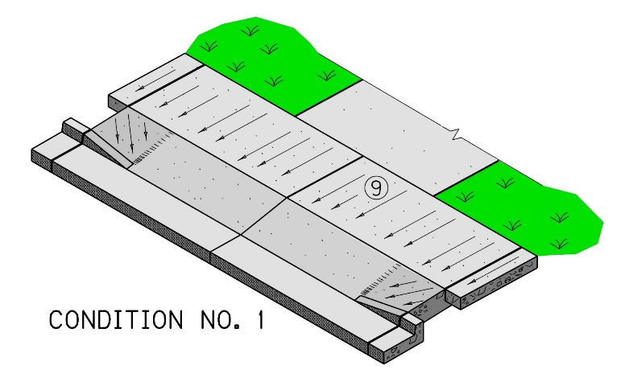
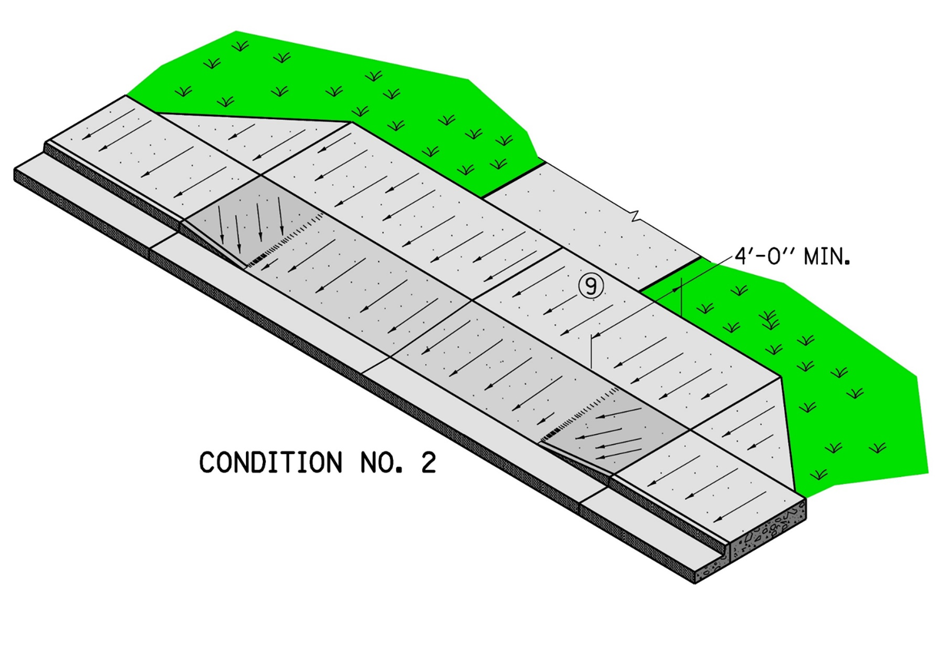
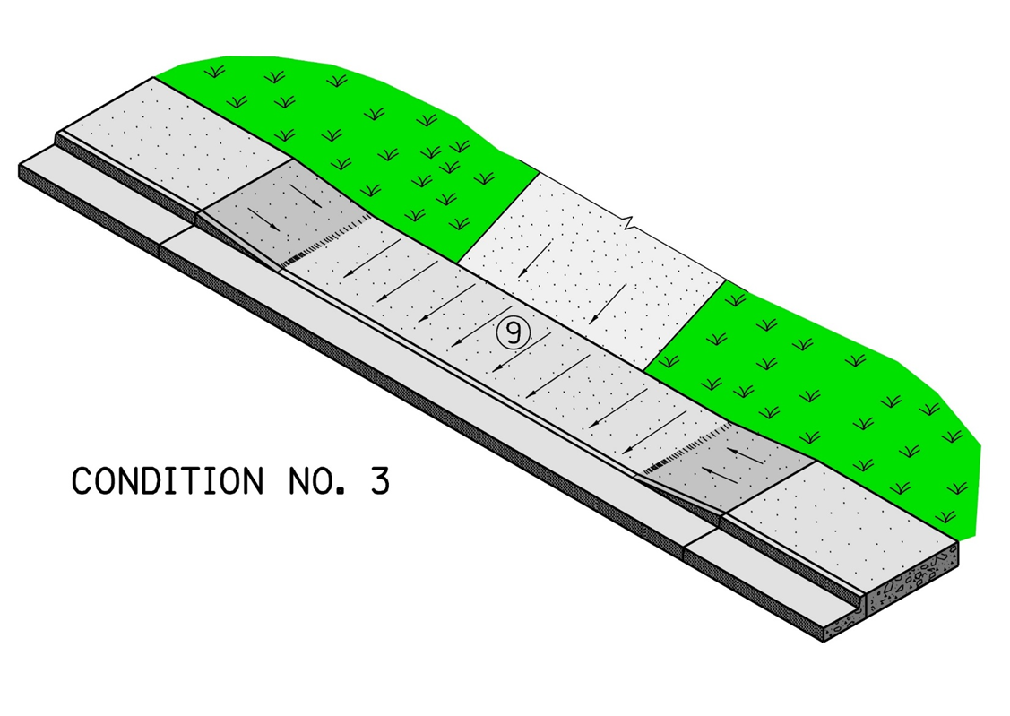
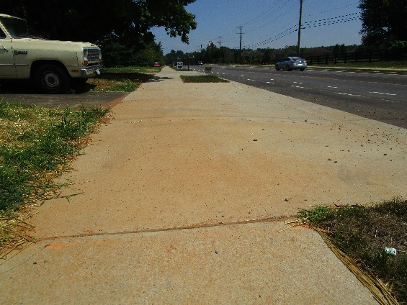
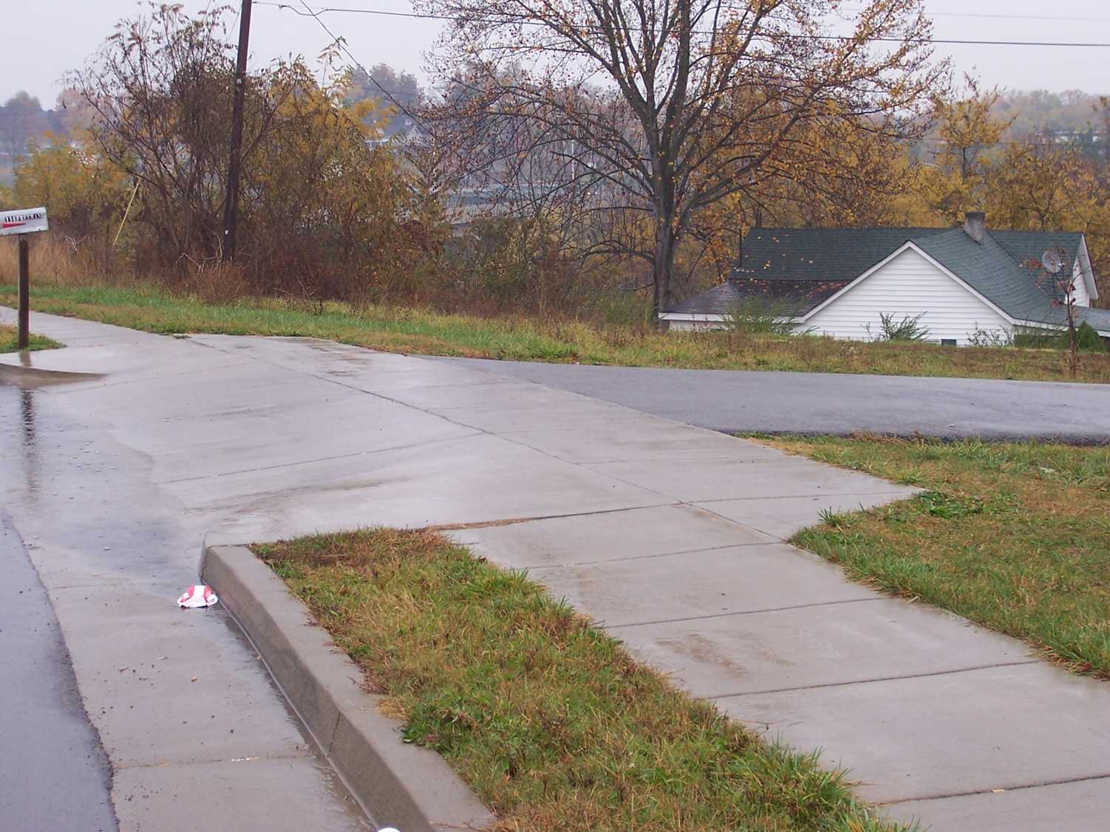
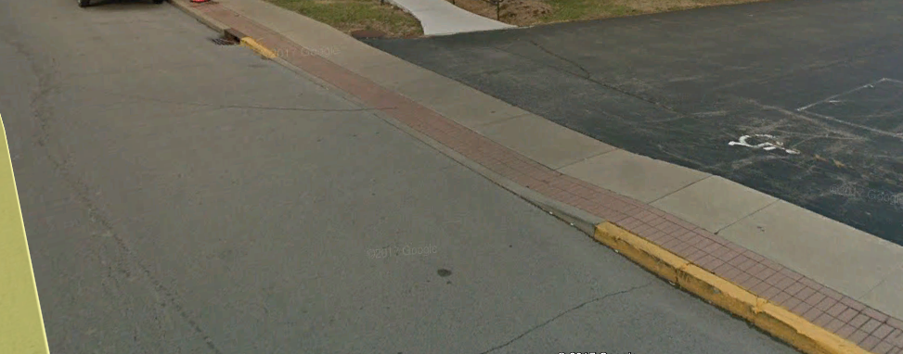
Driveways

Slide 17
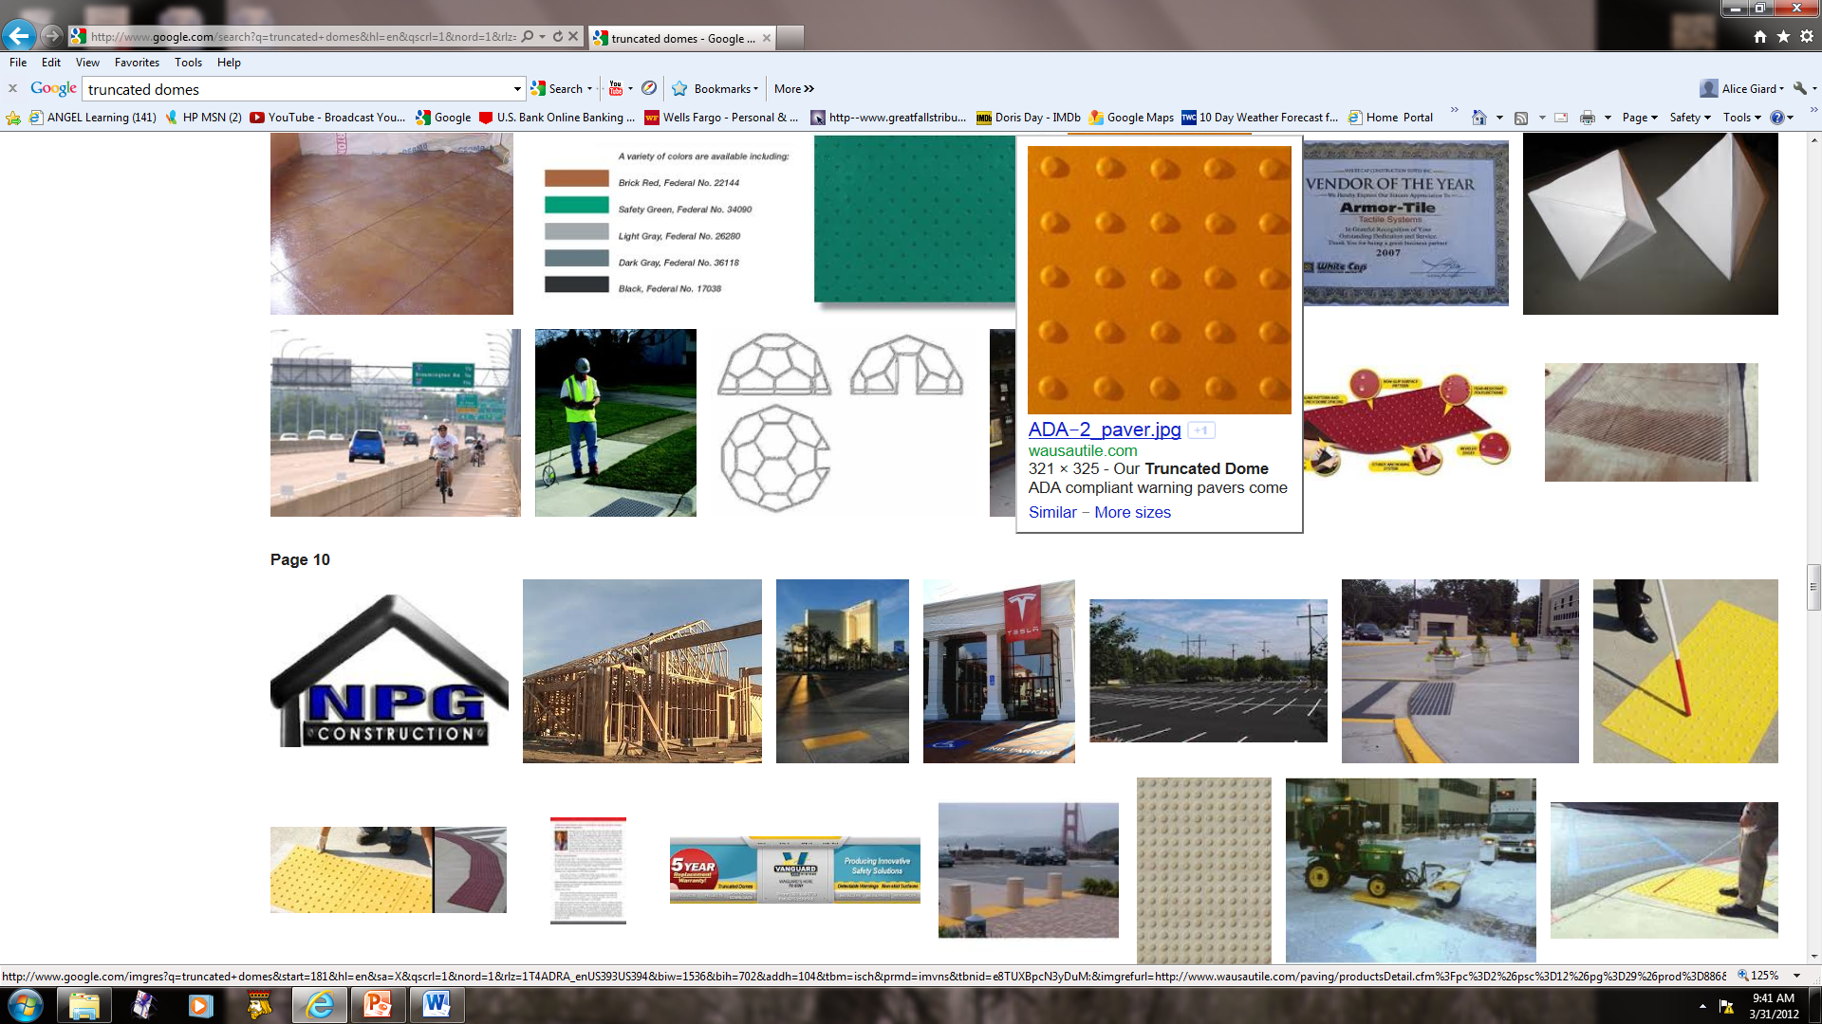
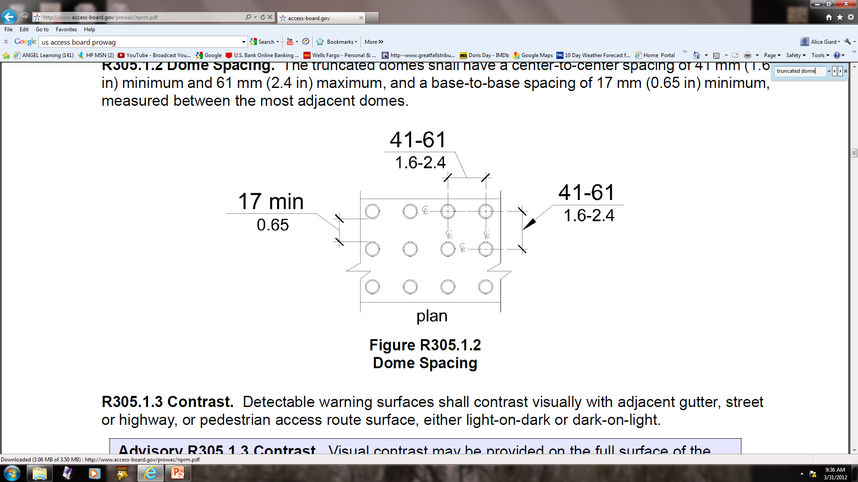
Detectable Warnings
(R208 and R305)
17
Notes:
Truncated domes (bumps) used as a tactile cue for vision impaired/blind pedestrians to indicate the entrance into traffic or the absence of a curb.

Slide 18
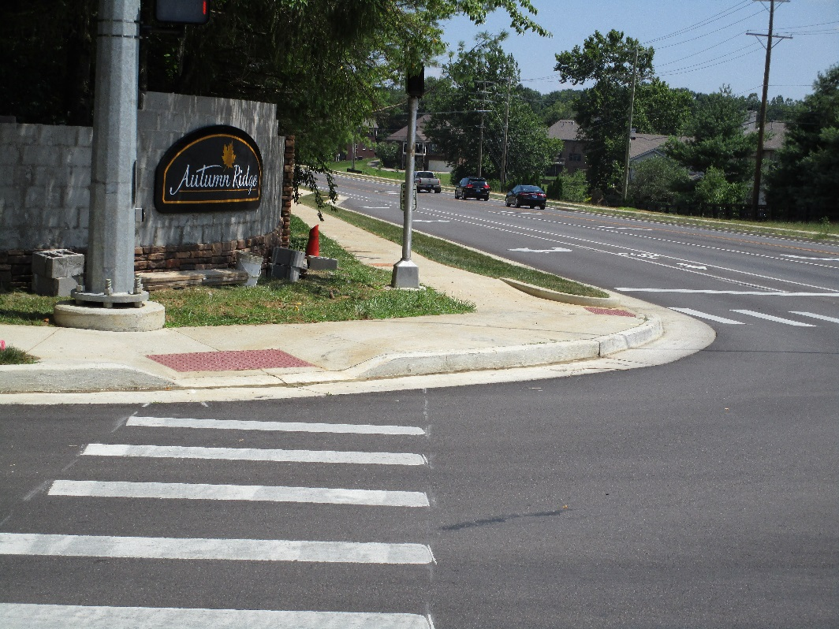
Perpendicular Curb Ramps (R304.2)
Flared sides max slope of 10%
Turning space
  Location: Where ramp comes off of the sidewalk
  Dimensions: 4 ft by 4 ft
  If constrained 4 ft by 5 ft (Direction of the ramp.)

Slide 19
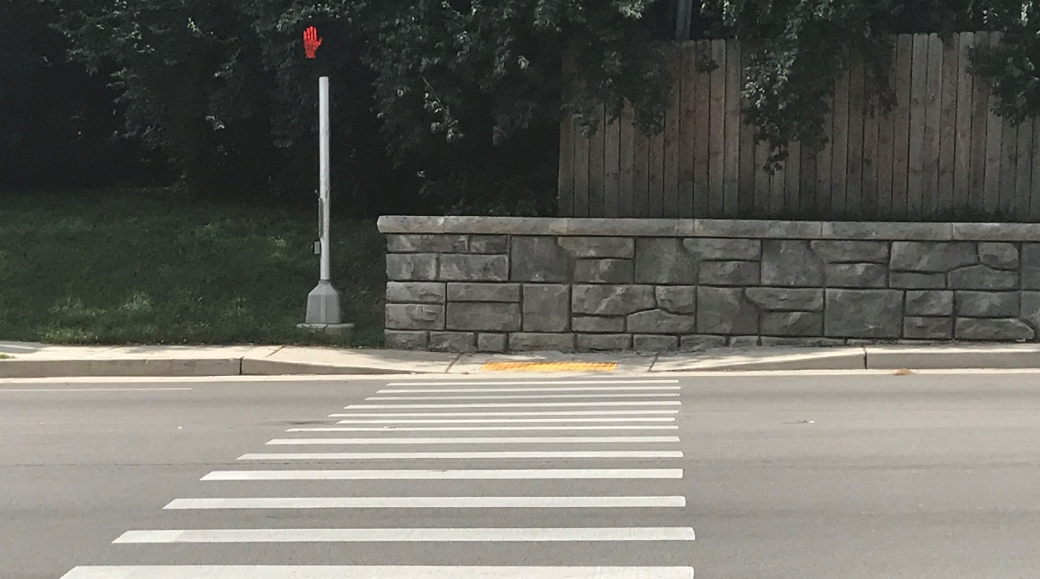
Parallel Curb Ramps (R304.3)
Turning Space:
  Dimension: 4 ft by 4 ft
  Location: Bottom of Ramp
  If Constrained: 4 ft by 5 ft (Direction of street crossing)

Slide 20
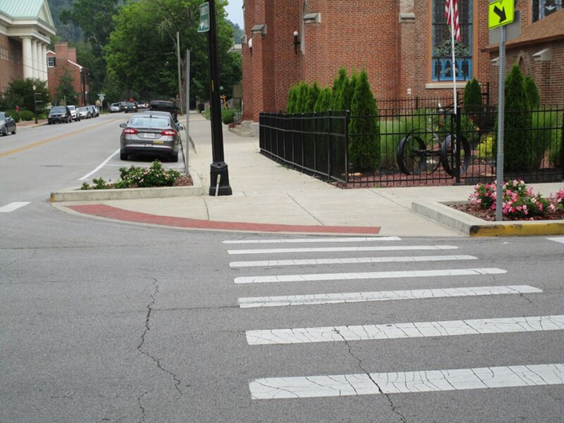
Blended Transition (R304.4)
Max Slope: 5%
Advantage: No turning space
Disadvantages:
  Pedestrian walk into street without knowing it.
  Vehicles use sidewalk for turns.

Slide 21
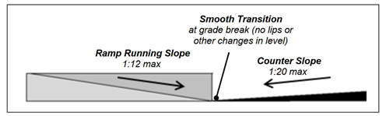
Common Requirements for Ramps
Dimensions (R304.5.2):
  Minimum 4 ft by 4 ft clear space at the bottom of the ramp within the crossing must be provided outside of the vehicle travel lane. (R304.5.5)
Slope
  Maximum cross slope is two percent. (R304.5.3)
  Maximum counter slope for the gutter or street at the foot of curb ramp runs, blended transitions, and turning spaces is five percent. (R304.5.4)
Notes:
Dimensions (R304.5.2):
Minimum 4 ft by 4 ft clear space at the bottom of the ramp within the crossing must be provided outside of the vehicle travel lane. (R304.5.5)
Minimum clear width is four feet (R304.5.2)

Slide 22
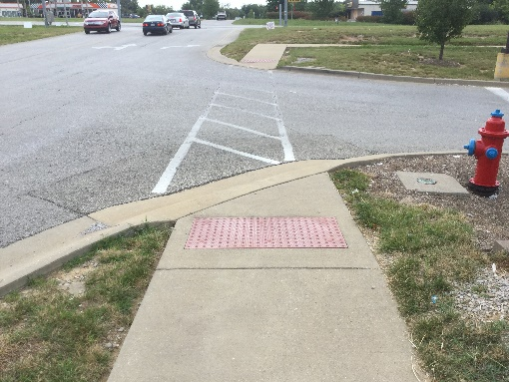
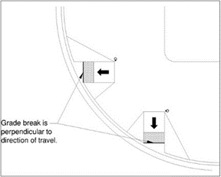
Common Requirements for Ramps
Grade Breaks (R304.5.2):
  None on ramp runs and turning spaces.
  Ones on the top and bottom of the ramps shall be perpendicular to the direction of the ramps run.
Best design practice to have the ramp & truncated dome facing the direction of the crosswalk.

Slide 23
If these and other features are unattainable then….
ADA Statement of
Technical Infeasibility

Slide 24



ADA Statement of
Technical Infeasibility

Slide 25
Any new construction must be accessible to persons with disabilities, except when KYTC can demonstrate it is structurally impracticable or technically infeasible to fully comply with the requirements of ADA.
[2010 ADAAG]
Notes:
New Construction refers to newly developed facilities within the scope of the project. Any new construction must be accessible to persons with disabilities, except when KYTC can demonstrate it is structurally impracticable or technically infeasible to fully comply with the requirements of ADA. The characteristics of the facilities or the terrain may make it physically impossible to construct facilities that are fully compliant. If full compliance with this section is technically infeasible, compliance is required to the extent that it is not technically infeasible. [2010 ADAAG]

Slide 26
On a Retrofit (Repair or Maintenance), the pedestrian access route shall be made accessible to the maximum extent feasible within the scope of the project. [2010 ADAAG]
Notes:
A Retrofit (Repair or Maintenance) is a change to an existing facility which impacts the pedestrian circulation path. The pedestrian access route shall be made accessible to the maximum extent feasible within the scope of the project. If full compliance with this section is technically infeasible, compliance is required to the maximum extent feasible. [2010 ADAAG]

Slide 27
A Technical Infeasibility determination means that due to existing physical or site constraints the facility (e.g. a sidewalk) cannot be built to comply with the minimum accessibility requirements.
(Reference: ADAAG; 4.1.6, (1), (j))
Notes:
Technically Infeasible: Means, with respect to an alteration a facility (e.g. a sidewalk), that full accessibility has little likelihood of being provided because other existing physical or site constraints prohibit modification or addition of elements, spaces, or features which are in full and strict compliance with the minimum requirements for new construction and which are necessary to provide accessibility. (Reference: ADAAG; 4.1.6, (1), (j))

Slide 28
What is KYTC’s ADA Statement of Technical Infeasibility?
The Form & Instruction Page are Available Online.
Go to www.
Notes:
With release of this memorandum, KYTC will now use the ADA Statement of Technical Infeasibility form (attached). The form will be used by KYTC personnel to detail site descriptions and explain the reasons behind technical infeasibility determinations. The attached Supplemental Instructions provides greater detail about the ADA evaluation process and serves as a guide during completion of the ADA Statement of Technical Infeasibility form.

Slide 29
What is the purpose of the ADA Statement of
Technical Infeasibility?
PURPOSE
1
To Document ADA Statement of Technical Infeasibility
Notes:
The Kentucky Transportation Cabinet (KYTC) coordinates many transportation projects that include pedestrian facilities. Occasionally, project conditions make it technically infeasible to fully comply with the ADA. Technical infeasibility means, with respect to an alteration a facility (e.g. a sidewalk), that full accessibility has little likelihood of being provided because other existing physical or site constraints prohibit modification or addition of elements, spaces, or features which are in full and strict compliance with the minimum requirements for new construction and which are necessary to provide accessibility. (Reference: ADAAG; 4.1.6, (1), (j)).

Slide 30
What is the purpose of the ADA Statement of
Technical Infeasibility?
PURPOSE
2
To Assist Engineers with a Technical Infeasibility Determination
Notes:
The Kentucky Transportation Cabinet (KYTC) coordinates many transportation projects that include pedestrian facilities. Occasionally, project conditions make it technically infeasible to fully comply with the ADA. Technical infeasibility means, with respect to an alteration a facility (e.g. a sidewalk), that full accessibility has little likelihood of being provided because other existing physical or site constraints prohibit modification or addition of elements, spaces, or features which are in full and strict compliance with the minimum requirements for new construction and which are necessary to provide accessibility. (Reference: ADAAG; 4.1.6, (1), (j)).

Slide 31

THE FORM
Available In A Digital
Format Or a Printable
Hard Copy
Self Explanatory

Slide 32
Notes:
Items 1 through 4 are self-explanatory.
Item 5: What type of work is being done?
New Construction refers to newly developed facilities within the scope of the project. Any new construction must be accessible to persons with disabilities, except when KYTC can demonstrate it is structurally impracticable or technically infeasible to fully comply with the requirements of ADA. The characteristics of the facilities or the terrain may make it physically impossible to construct facilities that are fully compliant. If full compliance with this section is technically infeasible, compliance is required to the extent that it is not technically infeasible. [2010 ADAAG]
A Retrofit (Repair or Maintenance) is a change to an existing facility which impacts the pedestrian circulation path. The pedestrian access route shall be made accessible to the maximum extent feasible within the scope of the project. If full compliance with this section is technically infeasible, compliance is required to the maximum extent feasible. [2010 ADAAG]
Items 6 through 9 are explained on the KYTC ADA Statement of Technical Infeasibility form.

Slide 33
N
Notes:
The Representation of the Facility graphic allows the person filling out the form to illustrate where the ADA technical infeasibility occurs. The graphic includes the intersection as well as the adjoining roadway segments. The intersection corners can be used to indicate ADA issues involving curb ramps, crosswalks, pedestrian push buttons, and sidewalks. The roadway segments can be used to indicate ADA issues for midblock crosswalks and sidewalks. Assign a route name to each segment and indicate the north direction by circling the correct arrow.

Slide 36
Notes:
Facility Type and Technical Dimensions Attained: KYTC inspectors should only check the boxes for facility types and components that cannot meet ADA accessibility requirements, i.e., where it is technically infeasible to build that facility type to meet ADA accessibility requirements. Additional details about each facility type are shown in items 11a-11e below. Immediately following is the list of acceptable technical infeasibility reasons.
A pedestrian crosswalk allows pedestrians to enter and cross a roadway, and to intersect a motorist’s path of travel. The PROWAG (2011) defines the crosswalk as another type of pedestrian access route. PROWAG crosswalk standards and definitions can be found in the following sections: crosswalk width (R302.3), crosswalk cross slope with stop control or yield (R302.6), crosswalk cross slope without stop control or yield (R302.6.1), crosswalk cross slope midblock (R302.6.2), and crosswalk running slope (R302.5).
Curb ramps provide a transitioning slope and join two paved surfaces at different elevations. For example, a curb ramp allows a person in a wheelchair to move between the sidewalk and the existing roadway. The PROWAG describes curb ramps as perpendicular, parallel, or blended transitions. Perpendicular curb ramps have a running slope that intersects the existing curb at a right angle. Parallel curb ramps have a running slope that is parallel to the joining sidewalk’s direction of travel. Blended transitions combine the competing pedestrian directions of travel into a raised pedestrian street crossing, depressed corner, or similar connection. PROWAG curb ramp standards and definitions can be found in the following sections: ramp running slope, perpendicular (R304.2.2); ramp running slope, parallel (R304.3.2); ramp width, perpendicular (R304.2.1); ramp width, parallel (R304.3.1); ramp width, blended transition (R304.5.1); ramp cross slope (R304.5.3); ramp flares (R304.2.3); landing dimensions (R407.6.2, R407.6.3); landing slope (R407.6.1); counter slope (R304.5.4); grade break (R304.5.2); and detectable warning system (R305.1.4).

Slide 37
Type in Additional Facility Types & Technical dimensions
If a Description for further Rationale for technical Infeasibilities or other contributing factors Apply, Please fill in description here. Photos can also be attached
Notes:
Pedestrian push buttons allow pedestrians to activate the walk signal and move safely through the crosswalk and across traffic. PROWAG push button standards and definitions can be found in the following sections: distance from sidewalk (R209.1), ramp width (R209.1), and mounting height (R209.1).
Sidewalks give pedestrians a separate travel path within the public right-of-way. The PROWAG also refers to sidewalks as pedestrian access routes. PROWAG crosswalk standards and definitions can be found in the following sections: continuous clear width (R302.3), sidewalk cross slope (R302.6), sidewalk running slope (R302.5), and pinch point, a.k.a. clear width exceptions (2010 ADAS 403.5.1).
Other includes pedestrian access route facilities and components that are not in the table, but are technically infeasible and do not meet ADA accessibility requirements. Describe these facilities and components in detail and include the KYTC standard, as-built dimensions, and technical infeasibility reason. Use this with great caution. Don’t abuse. You may be called to justify your stance so it needs to be defensible.
Rationale for Technical Infeasibility: KYTC personnel must provide detailed site descriptions that explain the reasons behind declaring technical infeasibility. For example, choosing historic preservation as a technical infeasibility reason may be described by stating that an existing historic preservation structure prevents the sidewalk standard width from being met (include site dimensions). In addition, the inspector should provide documentation in the form of photographs which further describes the technical infeasibility. Photographs should be attached separately to the form.

Slide 38

ADA Statement of
Technical Infeasibility
Questions?
Anthony Norman – Email Anthony.Norman@ky.gov
Jeff Jasper – Email Jeff.Jasper@uky.edu
Joe Tucker – Email Joseph.Tucker@ky.gov

Slide 39
ADA Compliant Sidewalks
Training coming
in the near future.

Slide 40
Thank you!
Any questions
Special thanks to the following who help put this presentation together.
  Keith Caudill, Jason Siwula, Vincent Thomas, Troy Hearn, Brent Sweger, Talya Estes, Skylar Hopper, and Michael Mabe!!

